Slide 1
Risk Identification Process
Prepared by Dr.M.MutasimBillah

Slide 2
Gary David Cohn once said, chief economic advisor to the US president
“If you don’t invest in risk management, it doesn’t matter what business you’re in, it’s a risky business.”

Slide 3
  identify Risks
This is the process of determining risks that may affect the project and assessing the impact of the risk should it occur. This information is documented in the risk register, a list of all of the identified risks, their root causes, categories and responses. Because the assessment of risk is an ongoing activity, the risk register will be updated continuously throughout the life of the project.
All project team members should be encouraged to identify risks and this is an iterative process because new risks may become known as the project progresses. The process should involve the project team so they can develop and maintain a sense of ownership and responsibility for the risks and associated risk response actions.

Slide 4
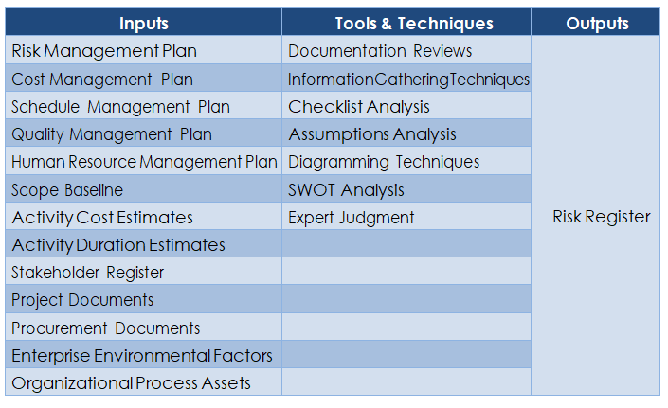
Risk Identification Process
The inputs, tools and techniques, and outputs of this process are summarized in the table below.

Slide 5
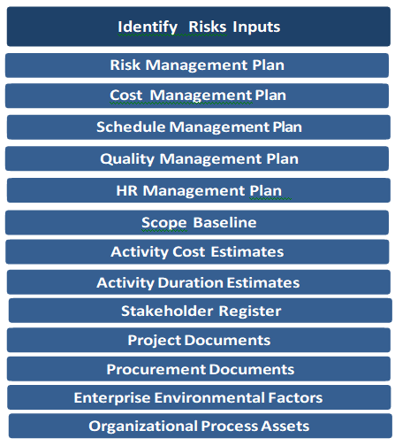
    Identify Risks: Inputs
This process requires the following inputs:

Slide 6
      Risk Management Plan
This is the sole output from the previous process. It defines the level of risk that is considered tolerable for the project, how all this will be managed, who will be responsible for them, what time and cost is needed for each, and how risk will be communicated.

Slide 7
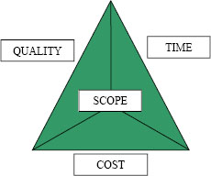
Cost, Schedule and Quality Management Plans
These plans describe how cost, schedule and quality are to be managed and implemented, and as such, the information contained within them will have a bearing on project risk.
Also Know as Iron Triangle

Slide 8
      Human Resource (HR) Management Plan
This plan provides guidance on how project human resources should be defined, staffed, managed, and eventually released. It can also contain roles and responsibilities, project organization charts, and the staffing management plan, which form a key input to identify risk process.

Slide 9
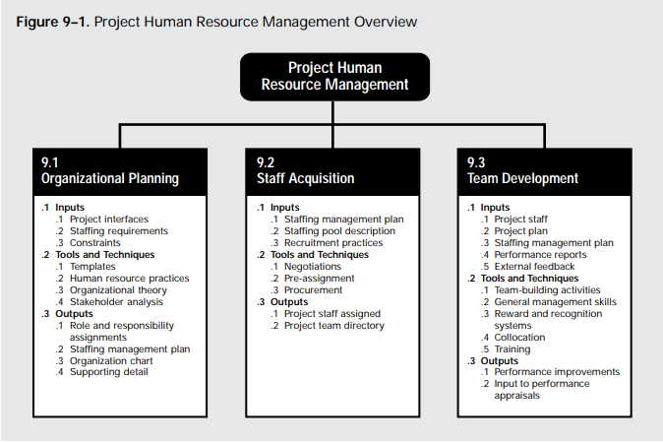

Slide 10
Organizational Planning—identifying, documenting, and assigning project roles, responsibilities, and reporting relationships.
Staff Acquisition—getting the human resources needed assigned to and working on the project. (new induction)
Team Development—developing individual and group skills to enhance project performance. (training)
Details are written in chap 9 of Pmbok.
Ref: (from PMBOK® Guide, Fifth Edition)

Slide 11
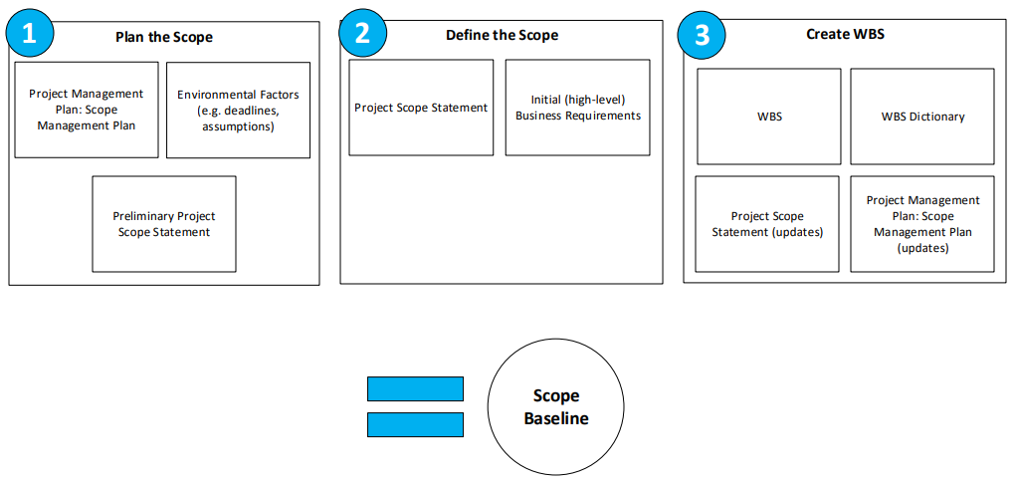
      Scope Baseline
The scope baseline is the approved version of a scope statement, WBS, and its associated WBS dictionary, which can be changed only through formal change control procedures and is used as a basis for comparison. It is a component of the project management plan.

Slide 12
Activity Cost Estimates
These are useful in identifying risk as they provide a quantitative assessment of the likely cost to complete scheduled activities. Reviewing these may indicate that the estimate is insufficient to complete the activity and hence poses a risk to the project.

Slide 13
      Activity Duration Estimates
These provide a quantitative assessment of the likely time to complete scheduled activities. Reviewing these may indicate that the estimate is insufficient to complete the activity and hence poses a risk to the project.
Example
Gantt Chart
CPM
Pert
Crashing time.
      Stakeholder Register
This lists all of the project stakeholders as well as describing and classifying them. This information will be useful in soliciting inputs for identifying risk, as it will ensure that key stakeholders participate in the process.

Slide 14

Delta’s Ground Crew Orchestrates a Smooth Takeoff (case Study)

Slide 15
Service For a Delta Jet
Passengers
Baggage
Fueling
Cargo and mail
Galley servicing
Lavatory servicing
Drinking water
Cabin cleaning
Cargo and mail
Flight services
Operating crew
Baggage
Passengers
Deplaning
Baggage claim
Container offload
Pumping
Engine injection water
Container offload
Main cabin door
Aft cabin door
Aft, center, forward
Loading
First-class section
Economy section
Container/bulk loading
Galley/cabin check
Receive passengers
Aircraft check
Loading
Boarding
0 10 20 30 40
Time, Minutes
Figure 3.4

Slide 16
CPM Example.
Milwaukee Paper Manufacturing had long delayed the expense of installing advanced computerized air pollution control equipment in its facility. But when the board of directors adopted a new proactive policy on sustainability, it did not just authorize the budget for the state-of-the-art equipment. It directed the plant manager, Julie Ann Williams, to complete the installation in time for a major announcement of the policy, on Earth Day, exactly 16 weeks away! Under strict deadline from her bosses, Williams needs to be sure that installation of the filtering system progresses smoothly and on time. Given the following information, develop a table showing activity precedence relationships.

Slide 17
AON Example
Table 3.1 | Milwaukee Paper Manufacturing’s Activities and Predecessors
ACTIVITY |  | DESCRIPTION | IMMEDIATE PREDECESSORS
A |  | Build internal components | —
B |  | Modify roof and floor | —
C |  | Construct collection stack | A
D |  | Pour concrete and install frame | A, B
E |  | Build high-temperature burner | C
F |  | Install pollution control system | C
G |  | Install air pollution device | D, E
H |  | Inspect and test | F, G
TIME (WEEKS)
2
3
2
4
4
3
5
2
25

Slide 18
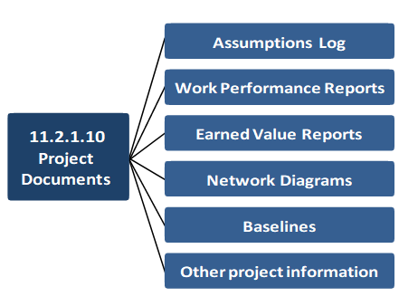
      Project Documents
These include, assumptions log, work performance reports, earned value reports, network diagrams, baselines, and other project information proven to be valuable in identifying risks.

Slide 19
      Procurement Documents
If the project requires external procurement of resources, procurement documents become a key input to this process. The complexity and the level of detail of the procurement documents should be consistent with the value of, and risks associated with, planned procurement. (eg supply chain risk, availability of resources on time)
      Enterprise Environmental Factors
These will have a major bearing on risks and will include laws and regulations governing the creation or use of the projects products. Also important is the operational environment within which the project is taking place. The views of the project stakeholders and their willingness to accept risk must also be taken into consideration.
      Organizational Process Assets
These include project files, including actual data, organizational and project process controls, risk statement templates, and lessons learned.

Slide 20
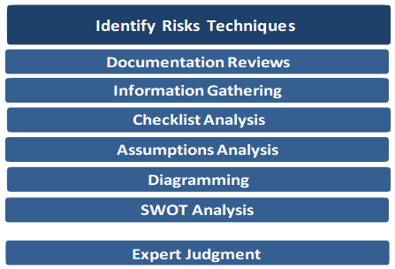
    Identify Risks: Tools and Techniques
There are seven tools and techniques that can be used.

Slide 21
      Documentation Reviews
These are structured reviews of all project documentation up to this point in time including plans, assumptions, previous project files, contracts, and other information.
The quality of the plans, as well as consistency between those plans and the project requirements and assumptions, can be indicators of risk in the project. Missing, inaccurate or incomplete information may hinder the identification of risks and may itself be a source of risk.

Slide 22
      Information Gathering Techniques
There are many ways in which information on the project risk situation can be gathered, and these include:
        Expert Interviews (project phases)
        Root cause identification (5 Why) eg oil is dropping from the car Apply 5 Why
        Brainstorming workshops
        The Delphi technique.
https://www.youtube.com/watch?v=SrlYkx41wEE
https://www.youtube.com/watch?v=zAs40EbTPnw

Slide 23
Class Activity
5 whys Titanic Exercise.

Slide 24
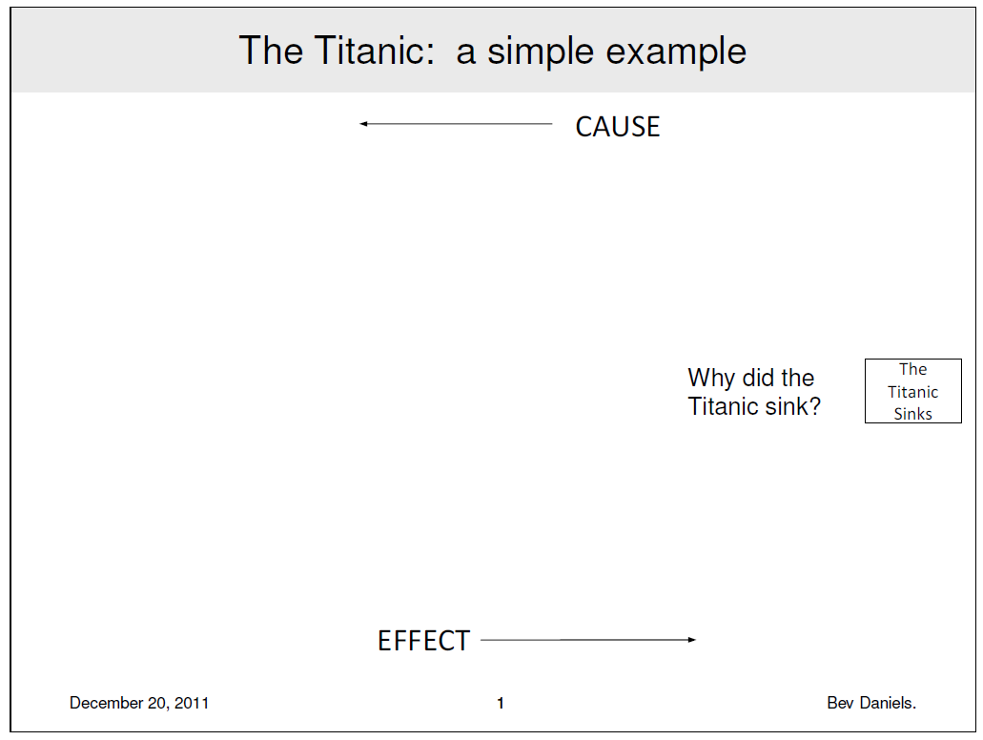

Slide 25
Brain Storming (example)
Our oceans are full of plastic waste, A lot of it is eaten by fish with uncertain effect to our health. According to the Economist by the year 2050 our ocean could contain more plastic than fish, measure in weight. So, how can we reduce waste from our Oceans?

Slide 26

Assumptions
Assumptions are an important part of any project. Assumptions usually require some type of follow-up or validation in order to determine whether or not they will impact the project.
No-one can predict future with perfect certainty, this is the reason we keep guessing while making decisions in our projects, businesses and life in general. These guesses are actually "Assumption " which become sources of Risk.
As per PMBOK , Assumption is defined as “ A factor in the planning process that is considered to be true, real, or certain, without proof or demonstration “.
Assumptions are documented in Project Charter during Project Initiation by Sponsor and in Project Scope Statement during Project Planning by Project Manager. The Project Plan would list down all the assumptions that are relevant to the current project.

Slide 27
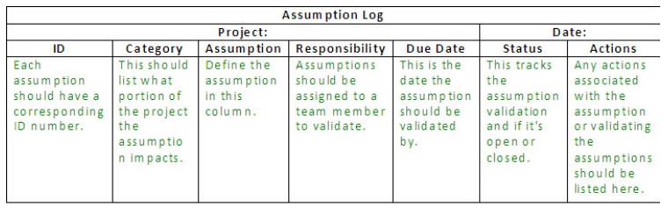
Assumption Log
The Assumption Log is a document which the project manager and team use to capture, document, and track assumptions throughout a project’s lifecycle.
Each assumption should have an owner or team member responsible for following up and validating the assumption. The Assumption Log assigns each assumption an ID or reference number, a name and description of each assumption, responsible person, due date, status, closure date, and any actions which might be required as part of the follow-up or validation.
The Assumption Log should be updated as items are closed or more information is obtained. The project team should also review the Assumption Log regularly to ensure all project team members are informed and any additional actions or information is captured.

Slide 28
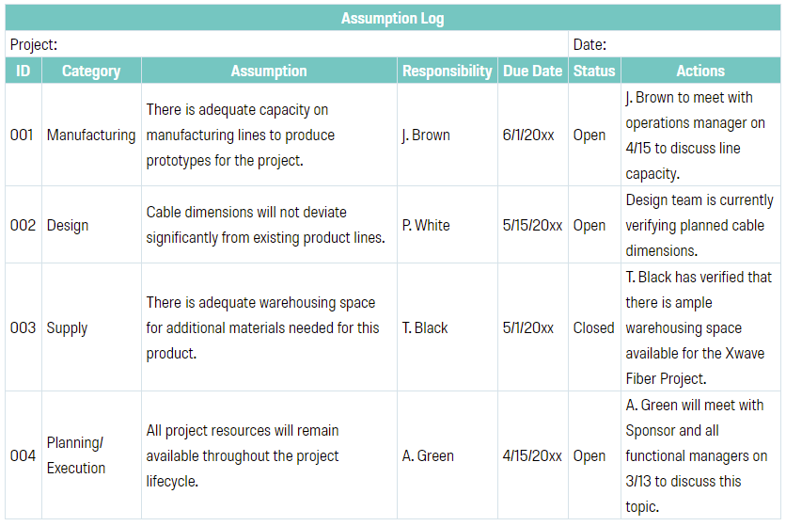
Assumption log Example

Slide 29
      Assumptions Analysis
As per PMBOK , Assumptions Analysis is defined as “A technique that explores the accuracy of assumptions and identifies risks to the project from inaccuracy, inconsistency, or incompleteness of assumptions.”
So, it is important for the project management team to review the justification or strength or support of the assumptions made. The risks are directly proportional to the consequences or the impacts to the project objectives if the assumption turns out to be wrong.
A simple IF-THEN statement can be written for each assumption, in the form : “IF this assumption proved to be false, THEN the effect on the project would be …”

Slide 30
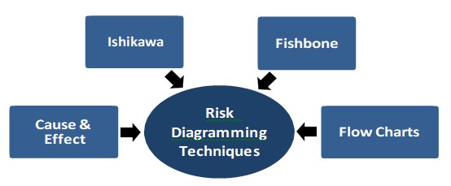
      Diagramming Techniques
Risk diagramming techniques may include cause and effect diagrams. These are also known as Ishikawa or fishbone diagrams, and are useful for identifying causes of risks.
Flow charts can also be used to show how various elements of a system interrelate, and the mechanism of causation, as can influence diagrams, which show causal influences, time ordering of events, and other relationships among variables and outcomes.

Slide 31
Cause & Effect Diagram
Money is not part of this diagram
Method
Machine
Medium Bone
Big Bone
Backbone
Poor
barbecue
Quality
Small Bone
Fine Bone
Man
Material

Slide 32
Cause-and-effect diagram for poor barbecue quality
Condiment
Meat
Not well thawed
Type
Consistency
Amount
Salt
Poor marbling
Content
Spices
Fat
Frozen too long
Marinade
Not tender
Age
Amount
Time
Type of cut
Grade of meat
Ingredient
Poor
barbecue
quality
In a hurry
On edge
Clean
Mood
Wind
Oiled
Rain
Rack
Attention
Starter
Temperature
Watch game on TV
Position
Charcoal
Talk to neighbor
Skill
Position
Type
Operator
Weather
Grill
Amount

Slide 33
Cause-and-effect diagram for “why tables are not cleared quickly”
Policy
Procedures
Waitress not available
Can’t start clearing
soon enough
Waitress spend too much time sorting dishes in kitchen – less time to clear
Not allowed to clear until entire party has left
Waitress must bring check to desk
Bottlenecks in kitchen
Takes too long to pay check
No standard training
Credit card machine jams
Empty tables
are not cleared
quickly
Not enough staff at busy times
Can’t Clear promptly
Customers drink coffee endlessly
Takes long time to get to kitchen
High turnover
Waitresses don’t care
Kitchen is far from tables
Poor morale
Poor pay
People
Physical Environment

Slide 34
Class Practice
Consider the everyday task of getting to work on time or arriving at your first class on time in the morning. Draw a fish-bone chart showing reasons why you might arrive late in the morning. Use 4M approach.(Man, Material, method, machinery)

Slide 35
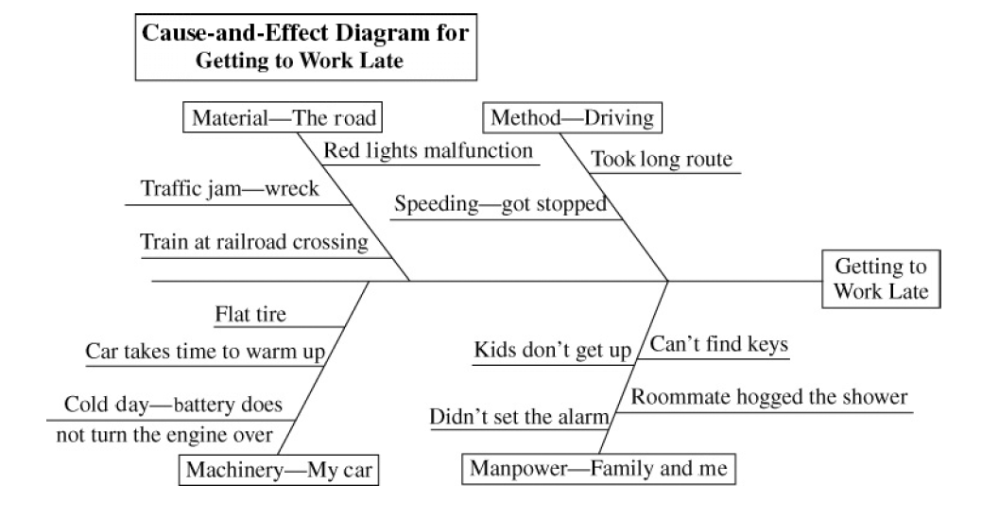

Slide 36

Analysis of Inadequate Production of Headers class exercise
A process improvement team is working to improve the production output at the Johnson Manufacturing plant’s Header Cell that manufactures a key component, headers, used in commercial air conditioners. A header is part of the circulatory system of a commercial air conditioner that moves coolant between various components such as the evaporator coil and the condenser coil. Currently, the header production cell is scheduled separately from the main work in the plant. Often, individual headers are not sequenced to match the product they go into on the final assembly line in a timely fashion, and so the product can sit in queue waiting for a header.

Slide 37



SOLUTION
As a first step, the team conducted extensive on-site observations across the six processing steps within the cell, followed by the transport of the finished header to the air conditioner assembly area for installation into an air conditioner unit. The six processing steps included:
1. Cut copper pipes to the appropriate length.
2. Punch vent and stub holes into the copper log.
3. Weld a steel supply valve onto the top of the copper log.
4. Braze end caps and vent plugs to the copper log.
5. Braze stub tubes into each stub hole in the copper log.
6. Add plastic end caps to protect the newly created header.
To analyze all the possible causes of the problem, the team constructed a cause-and-effect diagram, shown in Figure 2.13. The main problem, inadequate header production, is the head of the diagram. The team brainstormed all possible causes, and together they identified several major categories: management, manpower, method, measurement, machine, and materials, or the 6 M’s. Several suspected causes were identified for each major category.
Inadequate

Slide 38
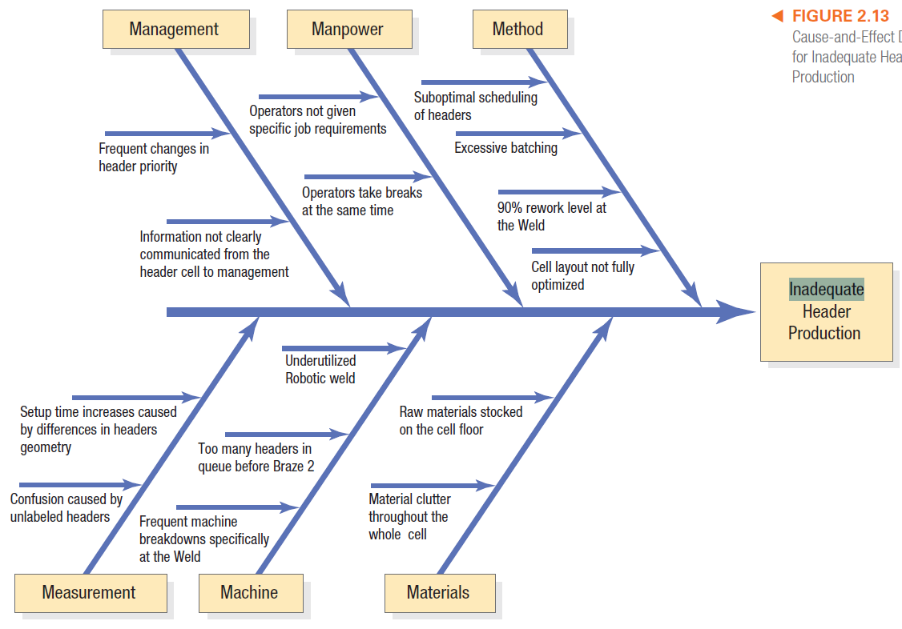

Slide 39
DECISION POINT
The improvement team noted several immediate issues that were slowing down production of headers. These issues included operators batching individual jobs (method branch) into groups to save walking time, which was further exasperated by the availability of raw materials stocked on the shop floor (materials branch) and the lack of specific job requirement (management branch). Further, there were many instances of individual tasks not being done correctly, and thus having to be redone; such as the 90 percent rework rate at weld (method branch). The next step in this process improvement was to eliminate the raw material on the floor, improve quality at the weld machine, and move each header individually using a header-specific cart.

Slide 40
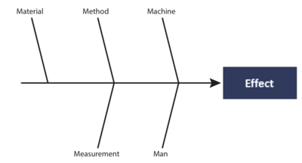
The first originates from lean manufacturing and the Toyota Production System, it is The 5 Ms
Machine (which covers the equipment and technology)
Method
Material (which covers both raw material, consumables, and knowledge)
Man (which covers both physical and knowledge work)
Measurement (which covers inspection and environment)
People
Material
Equipment/Machinery
Methods
Environment
Measurement

Slide 41
For Services another two standards exist:
The first considers these causes:
  People
  Policies
  Procedures
  Location (this usually includes equipment and machinery)
  Measurement
For Product Marketing this standard exists
The 8 Ps^{[7]}
  Product (would be service for Service Marketing)
  People
  Price
  Promotion
  Process
  Physical evidence
  Performance
  Place
The second one is called The 4 Ss^{[7]} and considers these causes
Surroundings
Suppliers
Systems
Skills

Slide 42
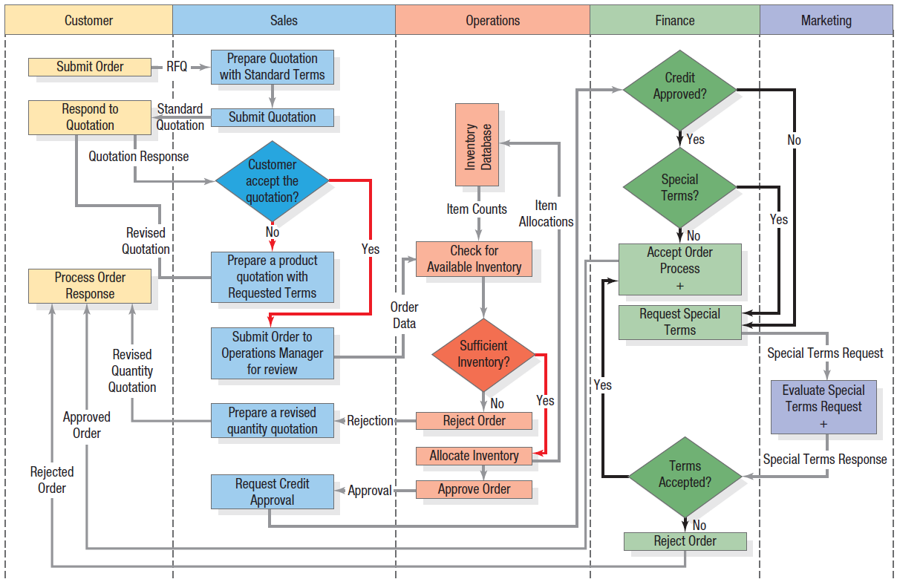
Swim Lane Flowchart

Slide 43
SWOT
SWOT analysis, also known as the SWOT matrix, is one of the techniques project managers and organizations have implemented in their risk management practices. SWOT stands for Strengths Weaknesses, Opportunities, and Threats.
It is a framework through which organizations and teams assess the pending internal and external influences that can affect a project, product or institution positively or negatively.
Let’s take a deeper look at how you can employ the SWOT technique to forecast, identify, resolve and guard against pending seen and unforeseen risks for a better project completion and success rate.

Slide 44


Slide 45
Class Discussion
Strabucks SWOT Analysis

Slide 46
Strengths, Weaknesses, Opportunities and Threats (SWOT).
Class Exercise
Highly Brill Leisure Center has hired you to help them with their marketing decision making.
Perform a SWOT analysis on Highly Brill Leisure Center, based upon the following issues:

Slide 47
The Center is located within a two-minute walk of the main bus station, and is a fifteen-minute ride away from the local railway station.
There is a competition standard swimming pool; although it has no wave machines or whirlpool equipment as do competing local facilities.
It is located next to one of the largest shopping centers in Britain.
It is one of the oldest centers in the area and needs some cosmetic attention.
Due to an increase in disposable income over the last six years, local residents have more money to spend on leisure activities.
There has been a substantial decrease in the birth rate over the last ten years.
In general people are living longer and there are more local residents aged over fifty-five now than ever before.
After a heated argument with the manager of a competing leisure center, the leader of a respected local scuba club is looking for a new venue.
The local authority is considering privatizing all local leisure centers by the year 2000.
Press releases have just been issued to confirm that Highly Brill Leisure Center is the first center in the area to be awarded quality assurance standard BS EN ISO 9002.
A private joke between staff states that if you want a day-off from work that you should order a curry from the Center’s canteen, which has never made a profit.
The Center has been offered the latest sporting craze.
Highly Brill Leisure Center has received a grant to fit special ramps and changing rooms to accommodate the local disabled.
It is widely acknowledged that Highly Brill has the best-trained and most respected staff of all of the centres in the locality.

Slide 48
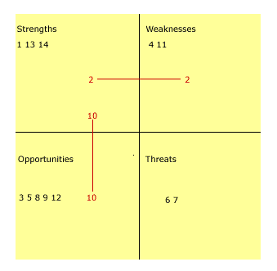

Slide 49
      Expert Judgment
Risks can be identified directly by experts with relevant experience of similar projects or business areas. Such experts should be identified by the project manager and invited to consider all aspects of the project and suggest possible risks based on their previous experience and areas of expertise.

Slide 50
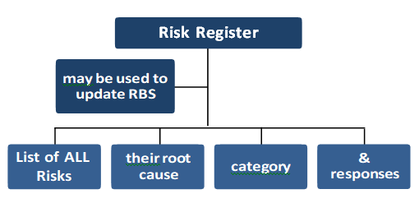
    Identify Risks: Outputs
This process will create the following output:

Slide 51
      Risk Register
This is the only output from this process and consists of the list of all the identified risks, their root causes, categories and responses. The information contained within the risk register may be used to update the risk breakdown structure.
Because of risk is an ongoing activity, the risk register will be updated continuously throughout the life of the project and it is a key tool to aid in the management of risks within a project. The risk register ultimately contains the outcomes of the other risk man- agement processes as they are conducted, resulting in an increase in the level and type of information contained in the risk register over time.

Slide 52
Risk Register
Dr.M.Mutasim Billah

Slide 53
GENERAL PROJECT RISK CHARACTERIZATION
1.Performance, scope, quality, or technological risks.
These include the risks that the project when complete fails to perform as intended or fails to meet the mission or business requirements that generated the justification for the project. Performance risks can also lead to schedule and cost risks if technological problems increase the duration and cost of the project.
2.Environment, safety, and health risks.
These include the risks that the project may have a detrimental effect on the environment or that hidden hazards may be uncovered during project execution. Serious incidents can have a severe impact on schedule and costs. (radioactivity, deforestation, extreme weather condition)

Slide 54
3.Schedule risk. This is the risk that the project takes longer than scheduled. Schedule risk may also lead to cost risks, as longer projects always cost more, and to performance risk, if the project is completed too late to perform its intended mission fully. Even if cost increases are not severe, delays in project completion reduce the value of the project to the owner.
4.Cost risk. This is the risk that the project costs more than budgeted. Cost risk may lead to performance risk if cost overruns lead to reductions in scope or quality to try to stay within the baseline budget. Cost risk may also lead to schedule risk if the schedule is extended because not enough funds are available to accomplish the project on time.

Slide 55
5.Loss of support. Loss of public or stakeholder support for the project’s goals and objectives may ultimately lead to a reduction of scope and to funding cuts, and thus contribute to poor project performance. (eg because of increase in dollar prices investor becomes reluctant in investing imported cars)
Source: The Owner’s Role in Project Risk Management, “THE NATIONAL ACADEMIES PRESS Washington” , D.C.

Slide 56
GRM Risk Categories
GRM Risk Categories From an extensive review of the literature, including the papers listed in Table 1, nine categories were identified. Respective risks determined for each category. The categories and associated risks are as follows.
(1) Technological and Operational Risk is sub-divided into operational, engineering, and performance risk. Operational risk includes lack of communication and coordination in the project, labor productivity and improper project planning. Engineering risk includes inadequate engineering designs, incomplete project scope, inadequate specifications, and differences between actual values and engineering assumptions. Performance risk includes technology limits and quality.
(2) Financial and Economic Risk is sub-divided into credit default, budget constraint/ scope creep, foreign exchange, inflation and interest rate, insurance, and funding risk. It includes credit fraud, changes in inflation or interest rates, and changes in the price of raw materials. For international projects, changes in exchange rates can cause budget pressures leading to cost overruns and/or decreases in the project performance or scope.

Slide 57
(3) Procurement and Contractual Risk is sub-divided into raw material procurement and subcontractor procurement risk. Raw material procurement risk is the delay due to market competition. Contractual risk involves issues or concerns associated with procurement through contractor.
(4) Political Risk is sub-divided into political instability and customer requirement risk. Political risk can be due to revisions in policies and rules, slow approvals, instable governments, or other bureaucratic hurdles. The political environment can impact projects during the implementation phase. Customer requirement risks can be caused by changes to customer technical or aesthetic requirements, which often lead to scope creep.

Slide 58
(5) Environmental Risk is sub-divided into weather and pollution risk. Risks to the project due to weather conditions such as rain, snow, or reduced sunlight are considered weather risks. Pollution risk is considered when the project affects the environment by generating pollution and vice versa. Generating pollution can result in delays and fines. Working in a polluted environment may affect the project’s performance or cause additional effort to successful complete the project.
(6) Social Risk is sub-divided into cultural relationship and society impact risk. Society impact risk occurs when a project has an effect on society. An example of social risk is the construction of a dam that could disturb the ecological balance of the region. Cultural relationship risk is often associated with global projects. In these situations misunderstanding the needs and sensitivities of the customer can impact the scope and operation of the projects.

Slide 59
(7) Regulatory and Legal Risk is risk sub-divided into litigation and non-compliance with codes and laws. Rules and regulations vary by country and industry sector. Changing regulations can impact a projects’ budget and/or schedule. The risk of litigation is great if rules are not properly followed.
(8) Safety Risk includes security risk. Security risk can be caused by many factors, such as acts of God, fire, theft, terrorism, and war. For example, floods or fire can drastically impact construction projects but they can influence any type of project if deliveries are impacted.
(9) Delay Risk is sub-divided into project delay and third party delay risk. Project delay risk can be caused by plan approval delays or other constraints. Third party delay risk is caused by delays by sub-contractors, suppliers, or vendors.
Reference: Murray, S. L., Grantham, K., & Damle, S. B. (2011). Development of a generic risk matrix to manage project risks. Journal of Industrial and Systems Engineering, 5(1), 35-51.

Slide 60
Framework to Identify Sources of Overall Project Risks
• PESTLE (political, economic, social, technological, legal, environment)
• TECOP (technical, environmental, commercial, operational, political)
• VUCA (volatility, uncertainty, complexity, ambiguity)
https://www.youtube.com/watch?v=rLOLdTjdnsY

Slide 61
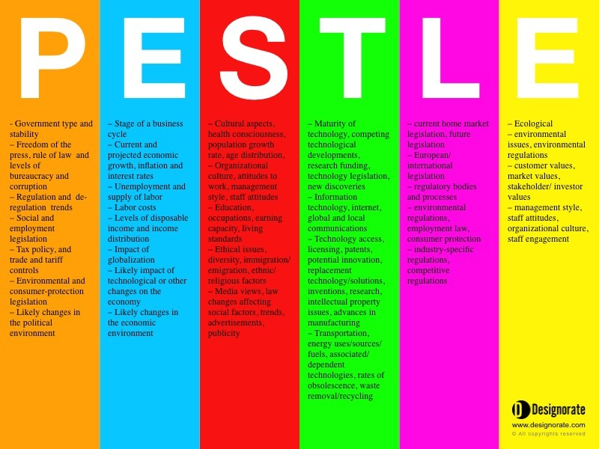
https://www.youtube.com/watch?v=_YhEpBvlO2M

Slide 62
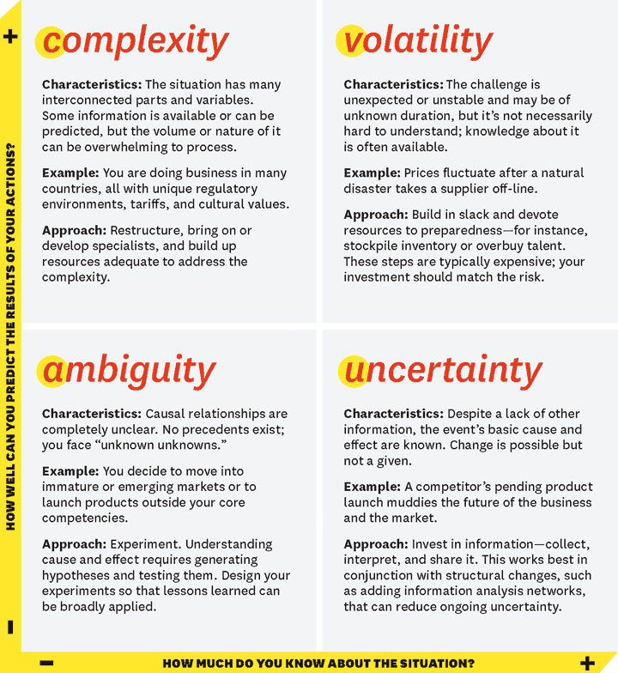
Reference: Harvard business review

Slide 63

How to identify risk??
Research Paper

Slide 64
Class Activity 1
Identify risk in your project area by using:
Brain storming.
Document review.
Checklist
Flow chart
Cause and effect diagram.

Slide 65
    Identify Risks: Outputs
This process will create the following output:

Slide 66
      Risk Register
This is the only output from this process and consists of the list of all the identified risks, their root causes, categories and responses. The information contained within the risk register may be used to update the risk breakdown structure.
Because of risk is an ongoing activity, the risk register will be updated continuously throughout the life of the project and it is a key tool to aid in the management of risks within a project. The risk register ultimately contains the outcomes of the other risk management processes as they are conducted, resulting in an increase in the level and type of information contained in the risk register over time.

Slide 67
List of identified risks.
The identified risks are described in as much detail as is reasonable. A structure for describing risks using risk statements may be applied, for example, EVENT may occur causing IMPACT, or If CAUSE exists, EVENT may occur leading to EFFECT. In addition to the list of identified risks, the root causes of those risks may become more evident.
These are the fundamental conditions or events that may give rise to one or more identified risks. They should be recorded and used to support future risk identification for this and other projects.

Slide 68
List of potential responses
Potential responses to a risk may sometimes be identified during the Identify Risks process. These responses, if identified in this process, should be used as inputs to the Plan Risk Responses process.

Slide 69
Activity 2
Update Risk Register by using identified risks in activity 1.

Slide 70
Perform Qualitative Risk Analysis
Perform Qualitative Risk Analysis is the process of prioritizing risks for further analysis or action by assessing and combining their probability of occurrence and impact. The key benefit of this process is that it enables project managers to reduce the level of uncertainty and to focus on high-priority risks. The inputs, tools and techniques, and outputs of this process are depicted in Figure 11-8. Figure 11-9 depicts the data flow diagram of the process.

Slide 71
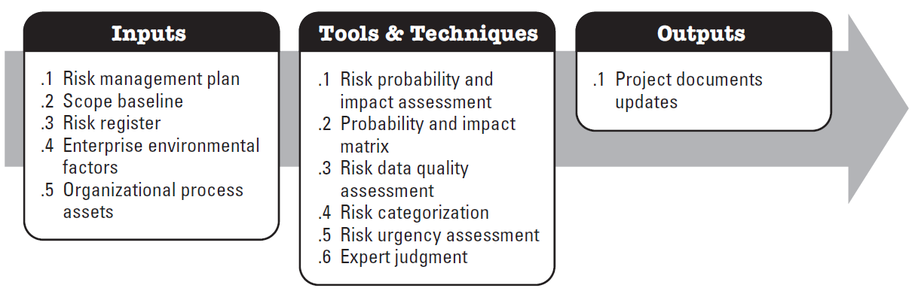
Process flow
The inputs, tools and techniques, and outputs of this process are summarized in the table below.

Slide 72
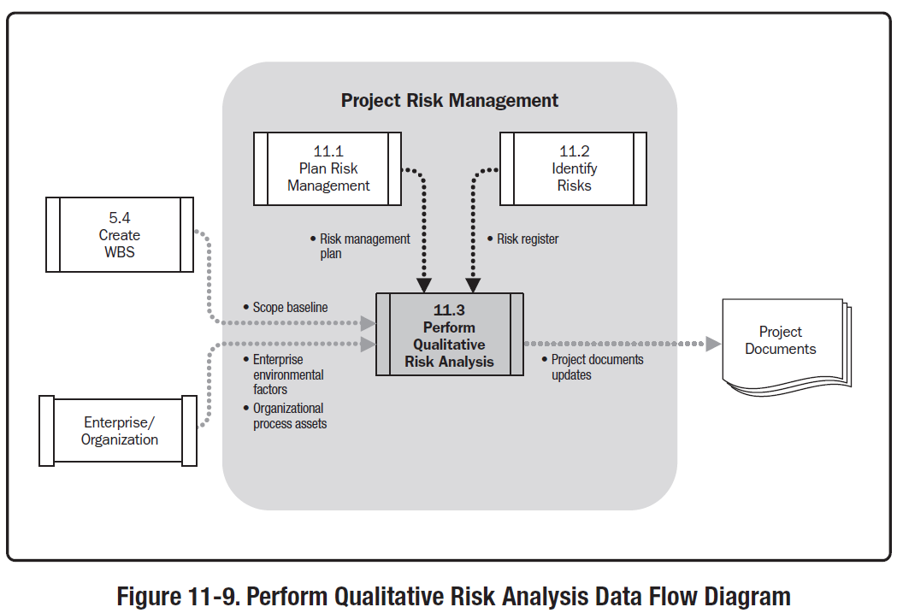
Data Flow Diagram

Slide 73
Perform Qualitative Risk analysis
This process analyses each risk from the risk register in terms of its probability and impact on the project if it were to occur. It should be performed as soon as possible after risks have been identified so that appropriate time and resources can be allocated to the more serious risks. It uses the probability and impact matrix (PIM) to rank and prioritize risks, and this information is placed back on the risk register.
Like all the processes within risk management, this one should be performed regularly because new risks will be identified and the characteristics of existing risks may change as the project progresses.

Slide 74
Perform Qualitative Risk Analysis: Inputs
      Risk Management Plan
This is developed during process ‘Plan Risk Management’ and will explain the overall approach that needs to be taken to risk management on this particular project. It will detail how much risk is acceptable and who should be involved in carrying out the qualitative analysis of the known risks.

Slide 75
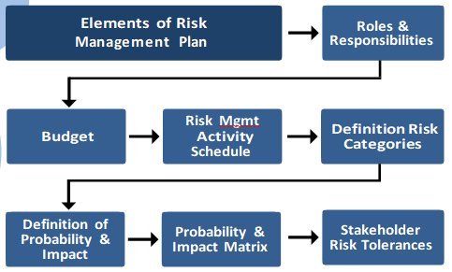
The key elements of this plan used in this process are roles and responsibilities for conducting risk management, budget, schedule for risk management activities, definition of risk categories, definition of risk probability and impact, probability and impact matrix, and stakeholder’s risk tolerances.

Slide 76
      Scope Baseline
The scope of the project will have a direct bearing on the type and amount of risk that is likely to be encountered. In general terms, certain types of project are associated with certain types of risk.
For example,
Construction projects the risks would include such things like, planning, permissions, weather, health and safety legislation, and labor union issues.
IT project risks tend to be concerned with whether development software will perform as advertised and with compatibility issues. (eg 5G)
Projects of a common or recurrent type tend to have well understood risks, whereas those breaking new ground tend to have more uncertainty.

Slide 77
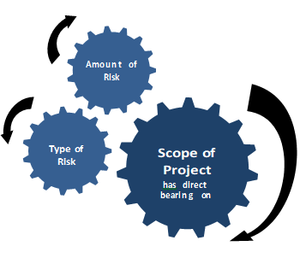

Slide 78
      Risk Register
This is the central repository of all of the known risks that are to be analyzed.
      Enterprise Environmental Factors
These include industry studies of similar projects by risk specialists and risk databases from industry or proprietary source.
      Organizational Process Asset
These will include the tools needed to carry out qualitative risk analysis, policies, procedures and guidelines for risk management, and historical information including lessons learned from previous projects.

Slide 79
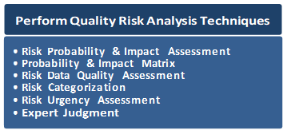
    Perform Qualitative Risk Analysis: Tools and Techniques

Slide 80
Perform Qualitative Risk Analysis: Tools and Techniques
Risk Probability and Impact Assessment
Risk probability assessment investigates the likelihood that each specific risk will occur. Risk impact assessment investigates the potential effect on a project objective such as schedule, cost, quality, or performance, including both negative effects for threats and positive effects for opportunities.
Probability and impact are assessed for each identified risk. Risks can be assessed in interviews or meetings with participants selected for their familiarity with the risk categories on the agenda. Project team members and knowledgeable persons external to the project are included.

Slide 81
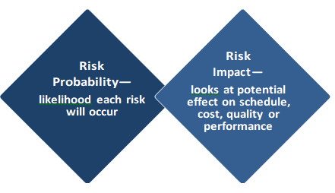
Risk Probability and Impact Assessment Cont.
The level of probability for each risk and its impact on each objective is evaluated during the interview or meeting. Explanatory detail, including assumptions justifying the levels assigned, are also recorded. Risk probabilities and impacts are rated according to the definitions given in the risk management plan. Risks with low ratings of probability and impact will be included within the risk register as part of the watch list for future monitoring.

Slide 82
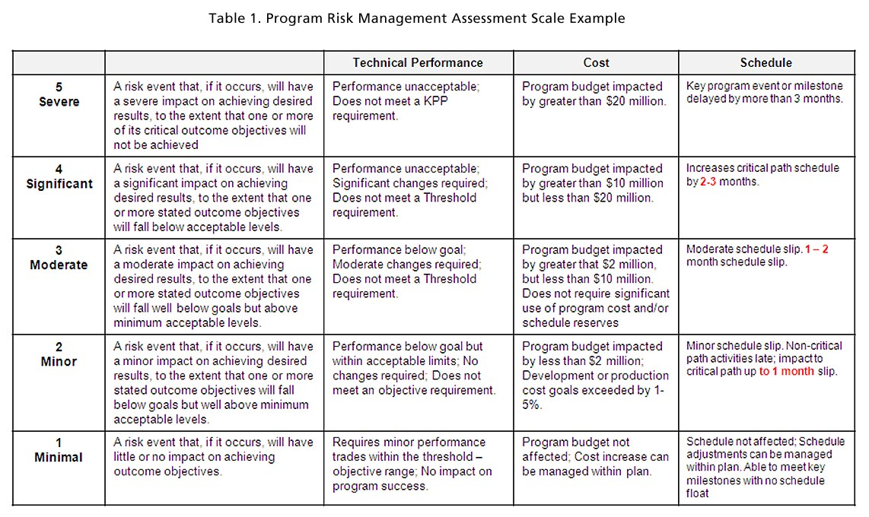

Slide 83
Probability and Impact Matrix
Risks can be prioritized for further quantitative analysis and planning risk responses based on their risk rating. Ratings are assigned to risks based on their assessed probability and impact. Evaluation of each risk’s importance and priority for attention is typically conducted using a look-up table or a probability and impact matrix. Such a matrix specifies combinations of probability and impact that lead to rating the risks as low, moderate, or high priority. Descriptive terms or numeric values can be used depending on organizational preference.

Slide 84
Probability Impact Matrix (PIM)
Very High
5
5A
5B
5C
5D
5E
High
4
4A
4B
4C
4D
4E
Medium
3
3A
3B
3C
3D
3E
Low
2
2A
2B
2C
2D
2E
Very Low
1
1A
1B
1C
1D
1E
Risk
Probability
(like hood)
Very Low
A
Low
B
Medium
C
High
D
Very High
E
Risk Impact (severity)
https://www.youtube.com/watch?v=-E-jfcoR2W0

Slide 85
Refer to research paper.

Slide 86

Example of a Risk Register
Risk Register for project "birthday party"
Risk Category | Risk Name | Risk Number | Probability (1-3) | Impact (1-3) | Risk Score | Mitigation | Contingency | Action By | Action When
Guests | The guests find the party boring | 1.1. | 2 | 2 | 4 | Invite crazy friends, provide sufficient liquor | Bring out the karaoke | Mack | within 2hrs
Guests | Drunken brawl | 1.2. | 1 | 3 | 3 | Don’t invite crazy friends, don't provide too much liquor | Bring in the guards | Jerry | Now
Nature | Rain | 2.1. | 2 | 2 | 4 | Have the party indoors | Move the party indoors | Milind | 10mins
Nature | Earthquake or fire | 2.2. | 1 | 3 | 3 | Start the party with instructions on what to do in the event of fire or earthquake | Implement the appropriate natural disaster response plan | Everyone | As per plan
Food | Not enough food | 3.1. | 1 | 2 | 2 | Have a buffer | Order pizza | Magua | 30mins
Food | Food is spoiled | 3.2. | 1 | 3 | 3 | Store the food in deep freezer | Order pizza | Zubair Malik | 30mins
R
I
S
K

Slide 87
Risk Data Quality Assessment
Risk data quality assessment is a technique to evaluate the degree to which the data about risks is useful for risk management. It involves examining the degree to which the risk is understood and the accuracy, quality, reliability, and integrity of the data about the risk.
The use of low-quality risk data may lead to a qualitative risk analysis of little use to the project. If data quality is unacceptable, it may be necessary to gather better data. Often, the collection of information about risks is difficult, and consumes more time and resources than originally planned.

Slide 88
Risk Categorization
Risks to the project can be categorized by sources of risk (e.g., using the RBS), the area of the project affected (e.g., using the WBS), or other useful categories (e.g., project phase) to determine the areas of the project most exposed to the effects of uncertainty. Risks can also be categorized by common root causes. This technique helps determine work packages, activities, project phases or even roles in the project, which can lead to the development of effective risk responses.

Slide 89
Risk Urgency Assessment
The purpose of this risk urgency assessment technique is to identify near term risks. We are trying to determine which risks are to be considered urgent. In other words, we are trying to identify those risks that require our immediate attention.
How to Identify a Near Term Risk?
According to the PMBOK guide, we can identify near-term risks by considering either/all of the below factors:
a. Time Available to put a risk response into motion – (Opportunity came for small time Timeframe)
b. The symptoms and/or warning signs of the risk – (Symptoms or Warning signs are also known as Risk Triggers.)
c. Risk rating score –

Slide 90
Expert Judgment
Expert judgment is required to assess the probability and impact of each risk to determine its location in the matrix shown in Figure. Experts generally are those having experience with similar, recent projects. Gathering expert judgment is often accomplished with the use of risk facilitation workshops or interviews. The experts’ bias should be taken into account in this process.

Slide 91
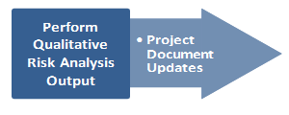
    Perform Qualitative Risk Analysis: Outputs

Slide 92
Project Documents Updates
The risk register can be updated with the following information.
Relative ranking or priority list of project risks—the probability and impact matrix can be used to classify risks according to their individual significance. Risks may be listed by priority separately for schedule, cost, and performance since organizations may value one objective over another. The project manager can then use the prioritized list of risks to focus attention on those items of high significance to the most important objectives.
Risks grouped by categories—this can point to common underlying causes of risk, which may in turn suggest a holistic approach to dealing with them. Discovering concentrations of risk may also improve the effectiveness of risk responses.
List of risks requiring response in the near-term—includes those risks that require an urgent response and those that can be handled at a later date may be put into different groups.

Slide 93
Cont.
List of risks for additional analysis and response—some risks might warrant more analysis, including Quantitative Risk Analysis, as well as response action.
Watch lists of low-priority risks—those that are not assessed as important in this process can be placed on a watch list for continued monitoring.
Trends in the analysis results—as this process is iterative, trends for particular types of risk may become apparent. This information can be fed back into the risk management process.
Assumptions Log—the project scope statement may contain assumptions about the project, which may be updated as a result of the qualitative risk analysis done in this process.

Slide 94
The END.

